Slide 1

Pest Management
Food Services
Presented by

Slide 2
Food Service Pest Management
Training and Compliance
Rodent Program
Insect Program
Birds and Wildlife
Weed Management

Slide 3
Training & Compliance
FIFRA requires that all pesticides be registered for every intended use, and that labels accompany each pesticide marketed. Application and handling requirements are specific to each pesticide product.
Under FIFRA, the use of pesticides in a manner inconsistent with labeling established by EPA is illegal.
Any technician performing pest management services in food plants must be trained and pass the Food Plant Pest Management exam administered by the NPMA.
Training and updating service logs should be performed yearly.

Slide 4
Training & Compliance
Right-to-Know sheets must be in every plant.
All pest management programs must comply with Current Good Manufacturing Practices (GMPs) set forth by the U.S. Food and Drug Administration.
      Labels and MSDS must be reviewed to make sure that all products have current information.
      MSDS and labels of pest management products used must be filed either in hard copy or electronically.
      All pesticides for use in pest management shall be stored off site or in a locked and secured storage area.

Slide 5
Training & Compliance
Service reports must contain full documentation of servicing.
If not documented, it never happened.
A master color map of all pest control devices used on the property must be maintained and kept current.
  Rodents=Red
  Insects=Purple
  Monitoring stations=Green

Slide 6
Rodent Program
Maintain records of all service verification.
Outdoor Rodent Management Plan
  A summary of infestation observations and potential infestation must be documented and presented to the pest management contact of the plant.
Indoor Rodent Management Plan
  All areas of the plant interior shall be surveyed for rodents and conditions which may lead to rodent infestation. Any rodent management devices shall be mapped and recorded.

Slide 7
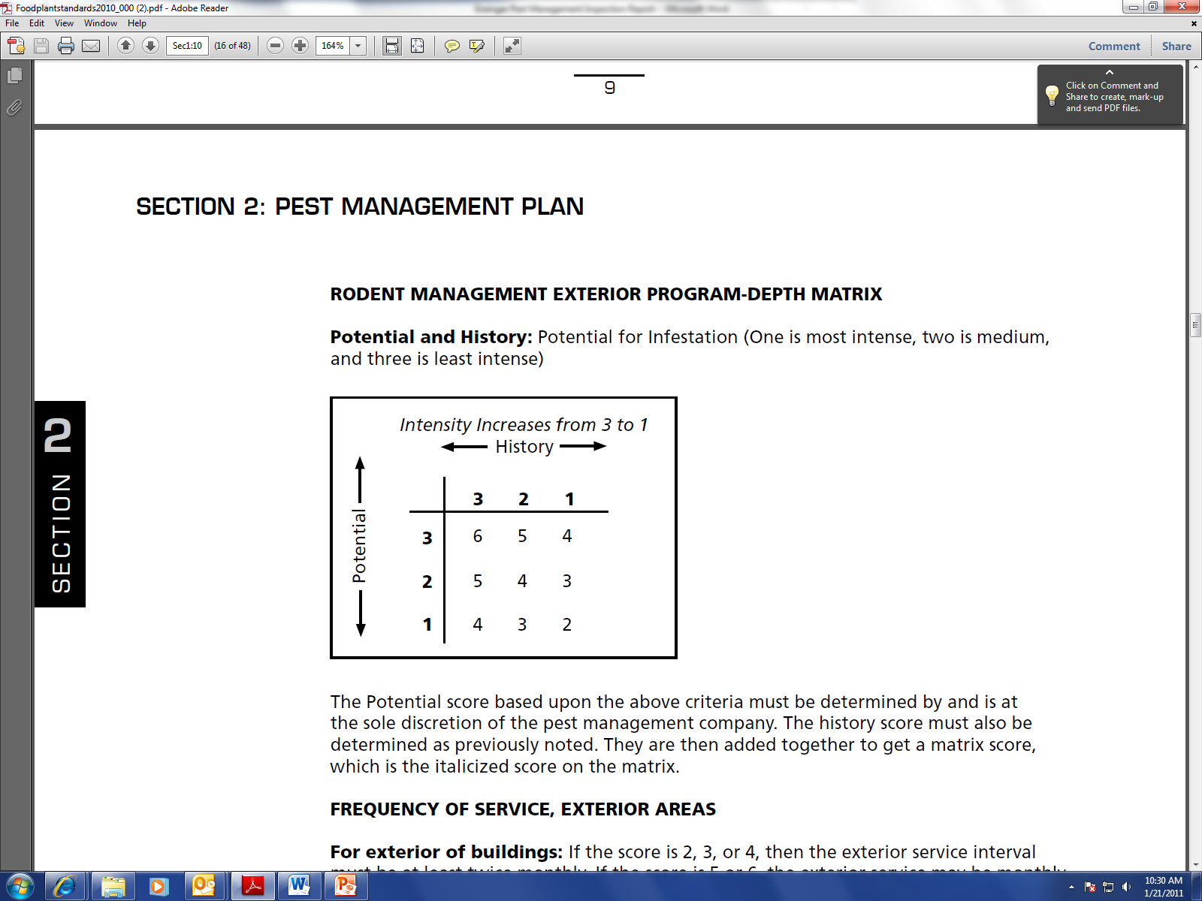
Outdoor Rodent Management Plan
    Depth Matrix Score: The sum of Potential &
    History Scores.
      History: Category 3-no significant evidence or history
      in the building in the past year; Category 2-no
      significant evidence or history in the past six months;
      Category 1-significant evidence or history in the past
      six months.
      Potential: Category 3-no significant potential for infestation due to plant maintenance and operations, and rodent pressure; Category 2-medium potential for infestation due to plant maintenance and operations, and rodent pressure; Category 1-high potential for infestation due to plant maintenance and operations, and rodent pressure.

Slide 8
Outdoor Rodent Management Plan
Products may only be within 50 feet of structures to minimize harm to non-target wildlife.
    Property Perimeter: Rodent management equipment (rodent bait stations or multiple-catch traps) shall be placed along property perimeter areas based on History Scores.
          Category 1: Spacing of not more than 50 feet
          Category 2: Spacing of 50-75 feet
          Category 3: Spacing of up to 100 feet

Slide 9
Outdoor Rodent Management Plan
    Exterior Building Areas: Rodent bait stations shall be placed along building exterior areas (buildings at or near exterior walls of buildings on plant property) based on the History Scores.
        Category 1: Spacing of not more than 25 feet
        Category 2: Spacing of between 25-50 feet
        Category 3: Spacing of up to 75 feet

Slide 10
Indoor Rodent Management Plan
    Multiple-catch traps may be supplemented at a rate determined by the technician with snap traps in stations or glue boards added into PVC pipes.
    The inside of any exterior wall should have multiple-catch traps or glue boards in stations at the rate of one every 20’ for mice and one every 40’ or more for rats.
    Rodenticides shall not be used inside food plants in any area unless approved by the plant contact and permitted by label.

Slide 11
Indoor Rodent Management Plan
    Rodent management devices should be added adjacent to doors, docks, and ramps, but may be placed adjacent to any exterior opening per company practices.
    Plants should have an inspection aisle of at least 18 inches along walls. This area is painted white in order to contrast with droppings or insects.
    Do not use peanut butter or nut based attractants inside a plant due to allergen concerns. Synthetic peanut butter may be approved for use.
    Rodents must be disposed of in a sanitary method offsite. Rodents, droppings, and any urine deposits or residue must be handled using protective gear.

Slide 12
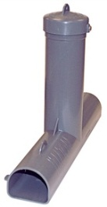
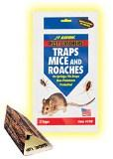
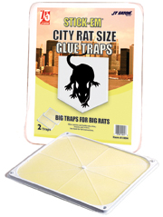
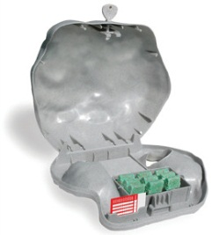
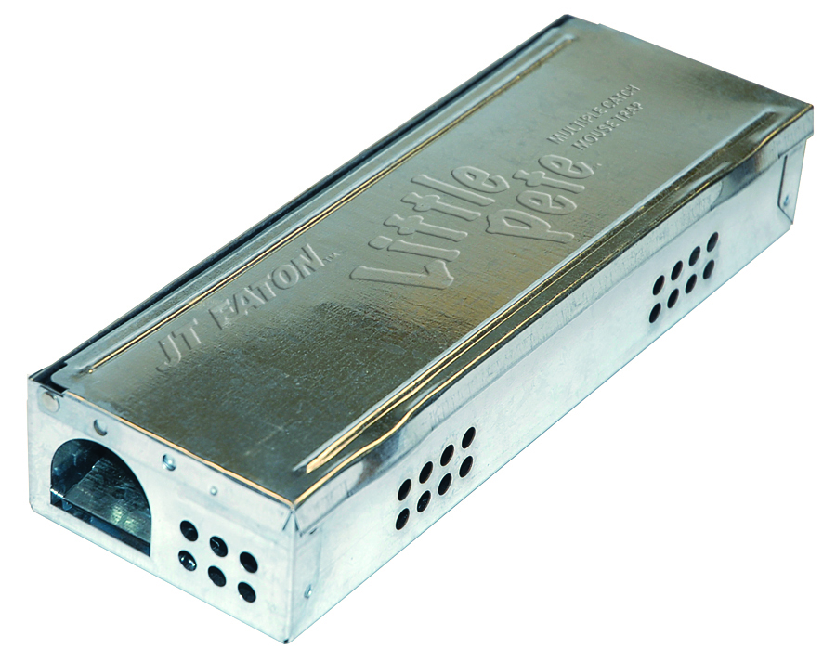
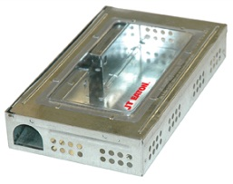
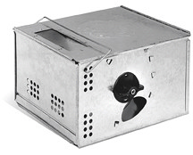
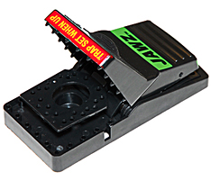
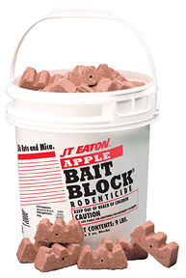
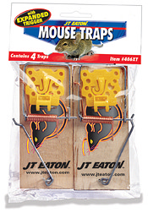
Rodent Management Products
    Rodent Rock Bait Stations
    Top Loading Bait Stations
    Bait Blocks
    Glue Traps
    Glue Boards
    Live Catch Mouse Traps
    Snap Traps

Slide 13
Insect Program
Conduct a thorough inspection of the exterior of the building.
Conduct a thorough inspection of the accessible components of the plant not less than monthly.
Pheromones and pheromone traps may be used as part of the monitoring and management processes.
Insects shall be managed using a product labeled for the site (residual or non-residual).
Space treatment may be used to reduce adult populations (including use of insect growth regulators- IGRs) as per label.

Slide 14
Insect Program
Insect Light Traps and Flying Insect Traps
  Insect light traps (ILTs) may be installed to monitor and manage certain flying insects (e.g. Indianmeal moths, fruit flies, etc.).
  Findings and seasonal requirements will dictate frequency of inspection.
  Placement (2-5 feet above floor level) must be according to manufacturer’s instructions and in compliance with any regulatory policies and guidelines.
  ILTs must be monitored based upon the contract and weekly monitoring is suggested.
  Bulbs in ILTs must be changed according to manufacturer’s recommendations (at least annually). Shatter protection must be in place where food or packaging may become contaminated by glass.
  Sticky type ILTs must be monitored at least monthly and the sticky board must be replaced if ineffective. Type of insects on the board must be recorded and categorized.

Slide 15
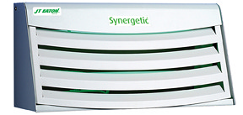
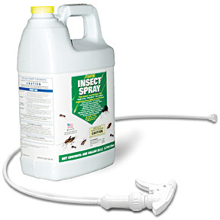
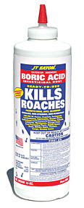
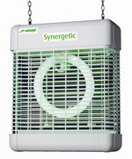
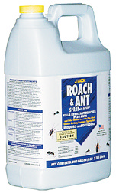
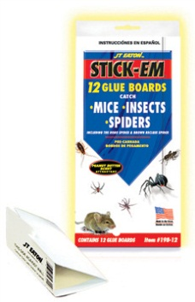
Insect Management Products
Insect Light Lamp
Powders
Glue Boards
Insecticides

Slide 16
Bird & Wildlife Management
Bird prevention measures may be installed. These shall be any type of wire, net, device, or material to prevent roosting.
Any interior bird removal shall be by trapping and removal in accordance with regulations.
Exterior infestations such as geese on grounds may be managed by scaring devices or repellents.
Use of protective gear shall be required for removal of nests and/or droppings.
Any miscellaneous animal removal shall be by trapping and removal in accordance with local regulations.
Exterior infestations such as prairie dogs on grounds may be managed by repellents or other method according to label or instructions.

Slide 17

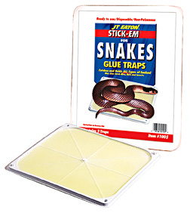
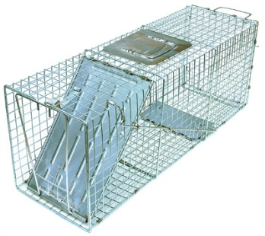
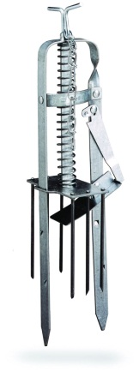
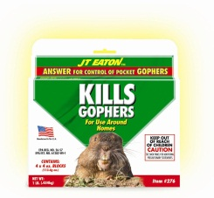
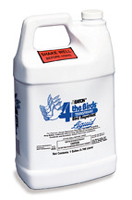
Bird & Wildlife Management Products
Scaring Devices
  Sound
  Visual
Netting Devices
Poison/Bait
Cages
Traps

Slide 18
Weed Management
  Vegetation should not be planted against the exterior of the buildings as it fosters rodent life.
  This area can also be filled with an 18” band of stone to prevent rodent burrowing.
  An inspection band and clear zone adjacent to the building should be encouraged as part of the periodic audit.

Slide 19
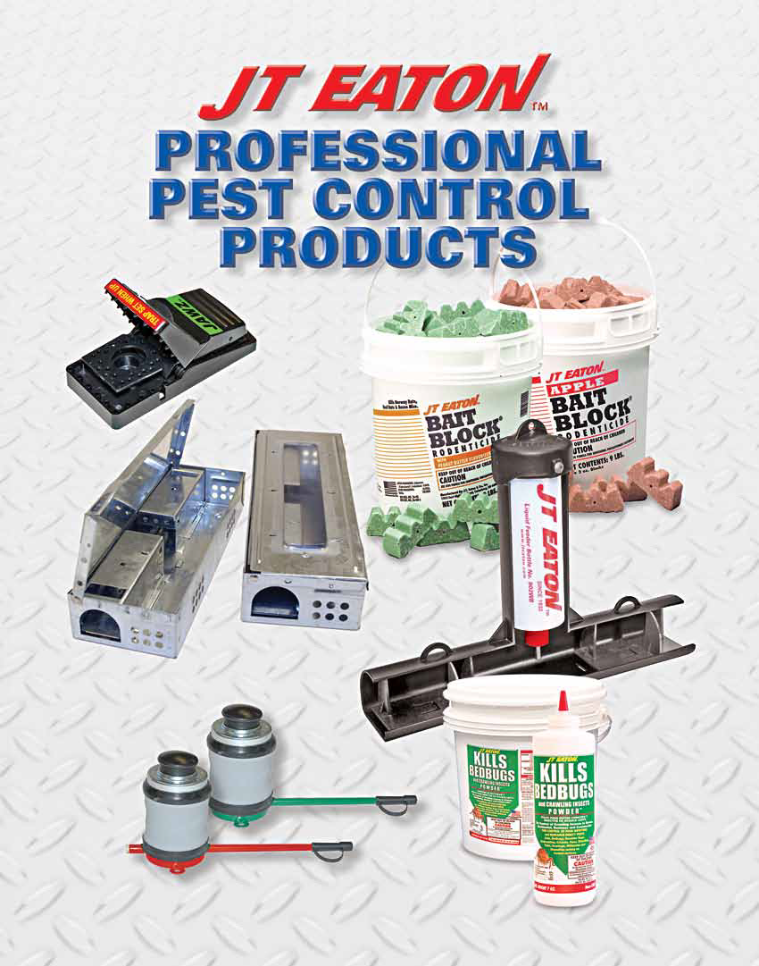

Slide 20
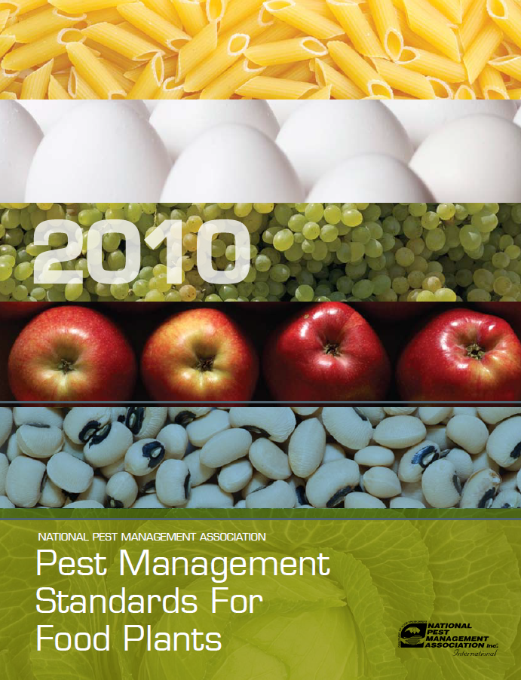
National Pest Management Assoc.
    For full details on Food Plant Standards, consult the Pest Management Standards for Food Plants put out by the National Pest Management Association.
NPMA
10460 North Street,
Fairfax, VA 22030
703-352-NPMA (6762)
fax 703-352-3031
www.npmapestworld.org

Slide 21
Other Sources of Information
    U.S. Food and Drug Administration
        Good Manufacturing Practices
      American Institute of Baking
        Food Safety Audits and Education

Slide 22
Questions?

