Slide 1
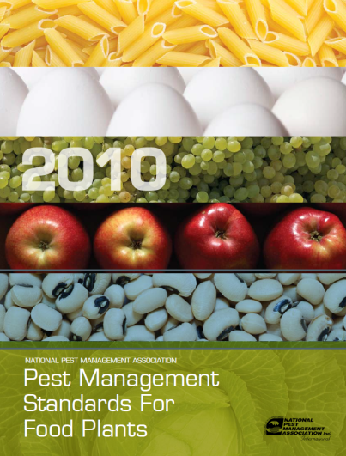

Pest Management
For Food Processing
Presented by

Slide 2
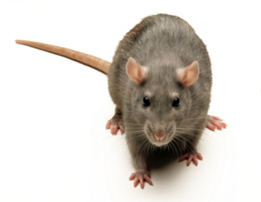
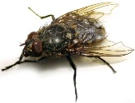

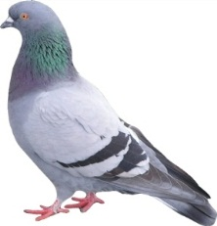
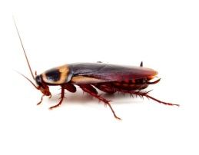
Food Processing Pest Management
Training and Compliance
Rodent Program
Insect Program
Birds and Wildlife
Weed Management

Slide 3
Training & Compliance
Federal Insecticide Fungicide Rodenticide Act (FIFRA) requires that all pesticides be registered for every intended use, and that labels accompany each pesticide marketed.
    Application and handling requirements are specific to each pesticide product.
Under FIFRA, the use of pesticides in a manner inconsistent with labeling established by EPA is illegal.
Service logs must be updated after every service.

Slide 4
Training & Compliance
Service reports must contain full documentation of servicing.
If not documented, it never happened.
A master map of all pest control devices used on the property must be maintained and kept current.
  Some use color coded maps to show the location of different types of devices.
  Others use an electronic scanning system to track devices.

Slide 5
Training & Compliance
All pest management programs must comply with Current Good Manufacturing Practices (GMPs) set forth by the U.S. Food and Drug Administration (FDA).
      Specimen labels and MSDS must be reviewed to make sure that all products have current information.
      MSDS and labels of pest management products used must be filed either in hard copy or electronically.
      All pesticides for use in pest management shall be stored off site or in a locked and secured storage area.
Right-to-Know information (including MSDS and Specimen Labels) must be available in every plant.

Slide 6
Rodent Program
Outdoor Rodent Management Plan
    A summary of infestation observations and potential infestation must be documented and presented to the pest management contact of the plant. Any rodent management devices shall be mapped and recorded.
Indoor Rodent Management Plan
    All areas of the plant interior shall be surveyed for rodents and conditions which may lead to rodent infestation. Any rodent management devices shall be mapped and recorded.
    Maintain records of all service verification.

Slide 7
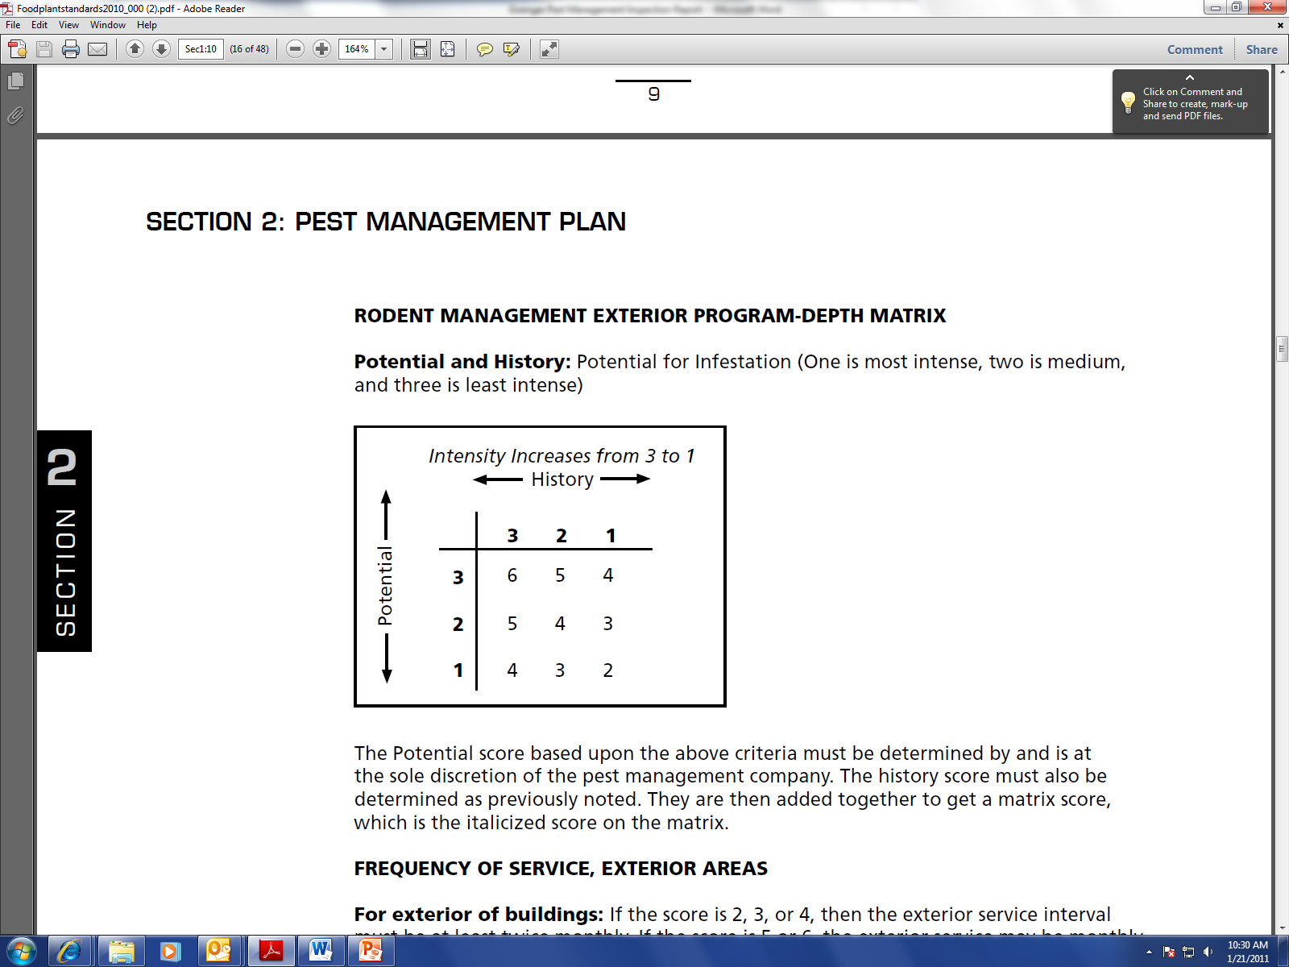
Outdoor Rodent Management Plan
    Depth Matrix Score: The sum of Potential &
    History Scores.
      History: Category 3-no significant evidence or history
      in the building in the past year; Category 2-no
      significant evidence or history in the past six months;
      Category 1-significant evidence or history in the past
      six months.
      Potential: Category 3-no significant potential for infestation due to plant maintenance and operations, and rodent pressure; Category 2-medium potential for infestation due to plant maintenance and operations, and rodent pressure; Category 1-high potential for infestation due to plant maintenance and operations, and rodent pressure.
      * Part of NPMA’s Pest Management Standards for Food Plants.

Slide 8
Outdoor Rodent Management Plan
If the total Depth-Matrix score is a 2, 3, or 4, then the exterior service interval must be at least twice monthly.
If the score is 5 or 6, the exterior service interval may be monthly.
Results should be reviewed by and accepted by plant contact and may be adjusted as necessary.

Slide 9
Outdoor Rodent Management Plan
Property Perimeter Program:
    Rodent management equipment (snap and glue traps or multiple-catch traps) shall be placed along property perimeter areas at spacing intervals determined by History Scores.
            Category 1: Spacing of not more than 50 feet apart
            Category 2: Spacing of 50-75 feet apart
            Category 3: Spacing of up to 100 feet apart
  Rodent bait products may only be used within 50 feet of structures to minimize harm to non-target wildlife.

Slide 10
Outdoor Rodent Management Plan
    Exterior Building Area Program:
      Rodent bait stations shall be placed along building exterior areas (at or near exterior walls of buildings on plant property) at spacing intervals determined by History Scores.
          Category 1: Spacing of not more than 25 feet
          Category 2: Spacing of between 25-50 feet
          Category 3: Spacing of up to 75 feet
      Other rodent management products may be used in place of bait stations.

Slide 11
Indoor Rodent Management Plan
    Multiple-catch traps may be supplemented at a rate determined by the technician with snap traps in stations or glue boards if placed into stations or covers (PVC pipes or Bait Stations).
    The inside of any exterior wall should have multiple-catch traps or glue boards in stations at the rate of one every 20 feet for mice and one every 40 feet or more for rats.
    Rodenticides shall not be used inside food plants in any area unless approved by the plant contact and permitted by label.

Slide 12
Indoor Rodent Management Plan
    Rodent management devices should be added adjacent to doors, docks, and ramps, but may be placed adjacent to any exterior opening per company practices.
    Plants must have an inspection aisle of at least 18-24 inches along walls. This area is painted white in order to contrast with droppings or insects.
    Do not use peanut butter or nut based attractants inside a plant due to allergen concerns. Synthetic peanut butter scents may be approved for use.
    Rodents must be disposed of in a sanitary method offsite. Rodents, droppings, and any urine deposits or residue must be handled using protective gear.

Slide 13
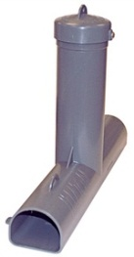
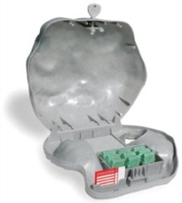
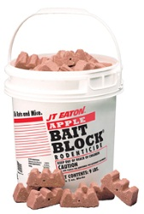
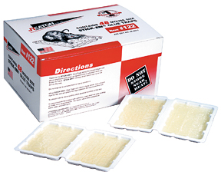
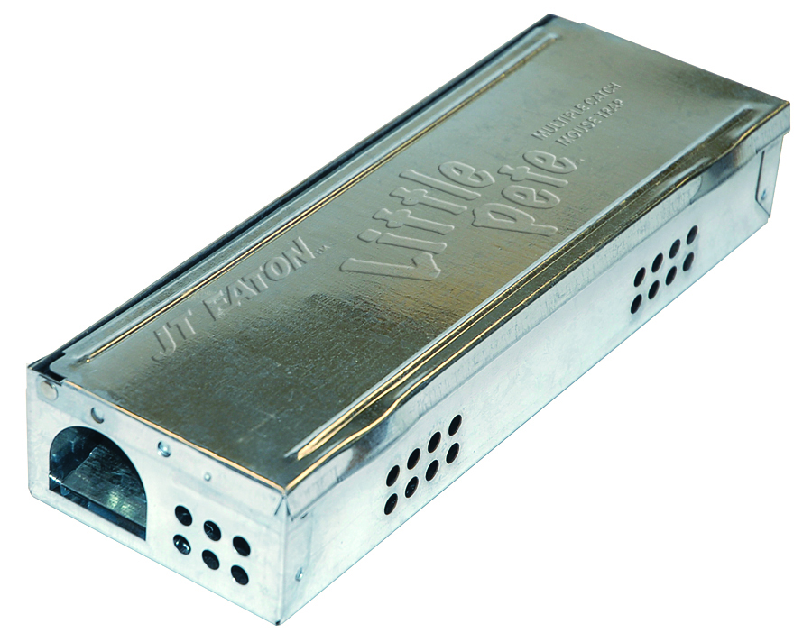
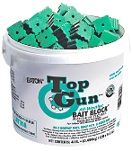
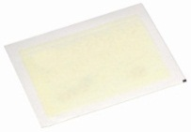
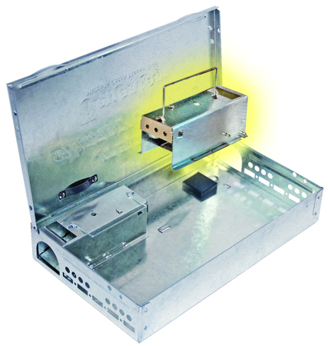
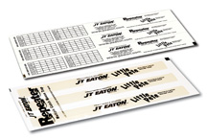
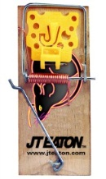
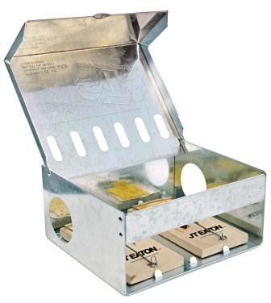
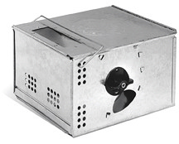
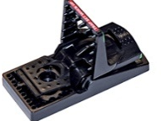
Rodent Management Products
    Rodent Bait Stations
    Bait Blocks
    Glue Traps
    Glue Boards
    Live Catch Mouse Traps
    Snap Traps

Slide 14
Insect Program
Conduct a thorough inspection of the exterior of the building for signs of rodent and insect activity.
Conduct a thorough inspection of the accessible components of the plant not less than monthly.
Pheromones and pheromone traps may be used as part of the monitoring and management processes.
Insects shall be managed using a product labeled for the site (residual or non-residual).
Space treatment may be used to reduce adult populations (including use of insect growth regulators- IGRs) as per label.

Slide 15
Insect Program
Insect Light Traps and Flying Insect Traps
  Insect light traps (ILTs) may be installed to monitor and manage certain flying insects (e.g. Indianmeal moths, fruit flies, etc.).
  Findings and seasonal requirements will dictate frequency of inspection.
  Placement (2-5 feet above floor level) must be according to manufacturer’s instructions and in compliance with any regulatory policies and guidelines.
  ILTs must be monitored based upon the contract.
  Bulbs in ILTs must be changed according to manufacturer’s recommendations (at least annually). Shatter protection must be in place where food or packaging may become contaminated by glass (and other areas dictated by inspectors).
  Sticky type ILTs must be monitored at least monthly and the sticky board must be replaced if ineffective. Weekly monitoring is suggested. Type of insects on the board must be recorded and categorized.

Slide 16
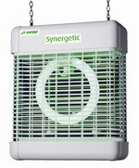
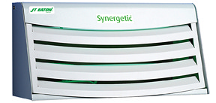
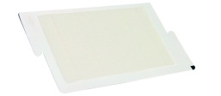
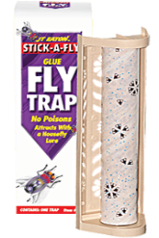
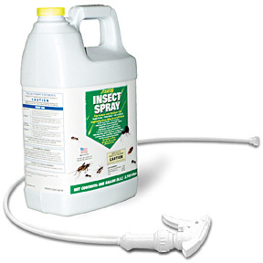
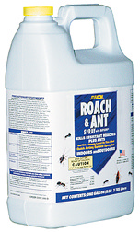
Insect Management Products
Insect Light Lamps
Glue Boards
Insecticides
Other Traps

Slide 17
Bird & Wildlife Management
Bird prevention measures may be installed. These shall be any type of wire, net, device, or material to prevent roosting.
Any interior bird removal shall be by trapping and removal in accordance with regulations.
Exterior infestations such as geese on grounds may be managed by scaring devices or repellents.
Use of protective gear shall be required for removal of nests and/or droppings.
Any miscellaneous animal removal shall be by trapping and removal in accordance with local regulations.
Exterior infestations such as prairie dogs on grounds may be managed by repellents, trapping or other methods according to label or instructions.

Slide 18
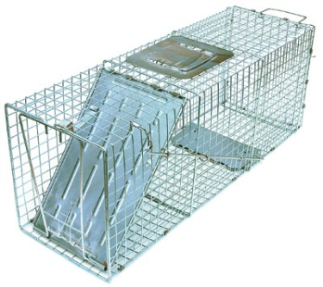
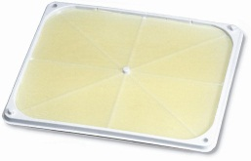
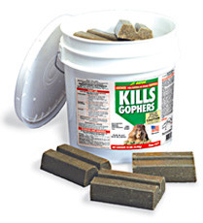
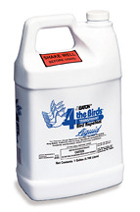
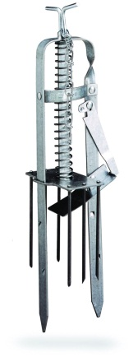

Bird & Wildlife Management Products
Scaring Devices
Netting Devices
Poison/Bait
Repellants
Cages
Traps

Slide 19
Weed Management
  Vegetation should not be planted against the exterior of the buildings as it fosters rodent and insect life.
  This area can be filled with an 18-24 inch band of stone to prevent rodent burrowing and insect ingress.
  An inspection band and clear zone adjacent to the building should be encouraged as part of the periodic audit.

Slide 20
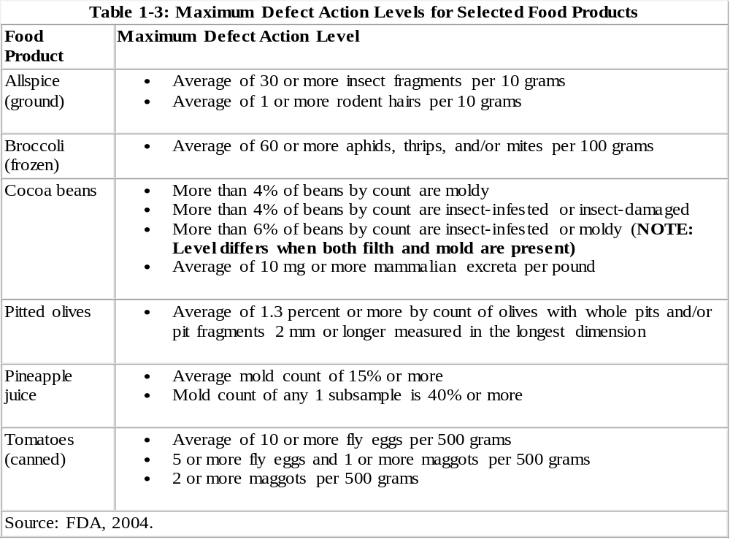

Slide 21

National Pest Management Association
    For full details on Food Plant Standards, consult the Pest Management Standards for Food Plants put out by the National Pest Management Association.
NPMA
10460 North Street,
Fairfax, VA 22030
703-352-NPMA (6762)
fax 703-352-3031
www.npmapestworld.org

Slide 22


Other Sources of Information
    U.S. Food and Drug Administration
        Good Manufacturing Practices
        American Institute of Baking
        Food Safety Audits and Education

Slide 23
Questions?

