Slide 1

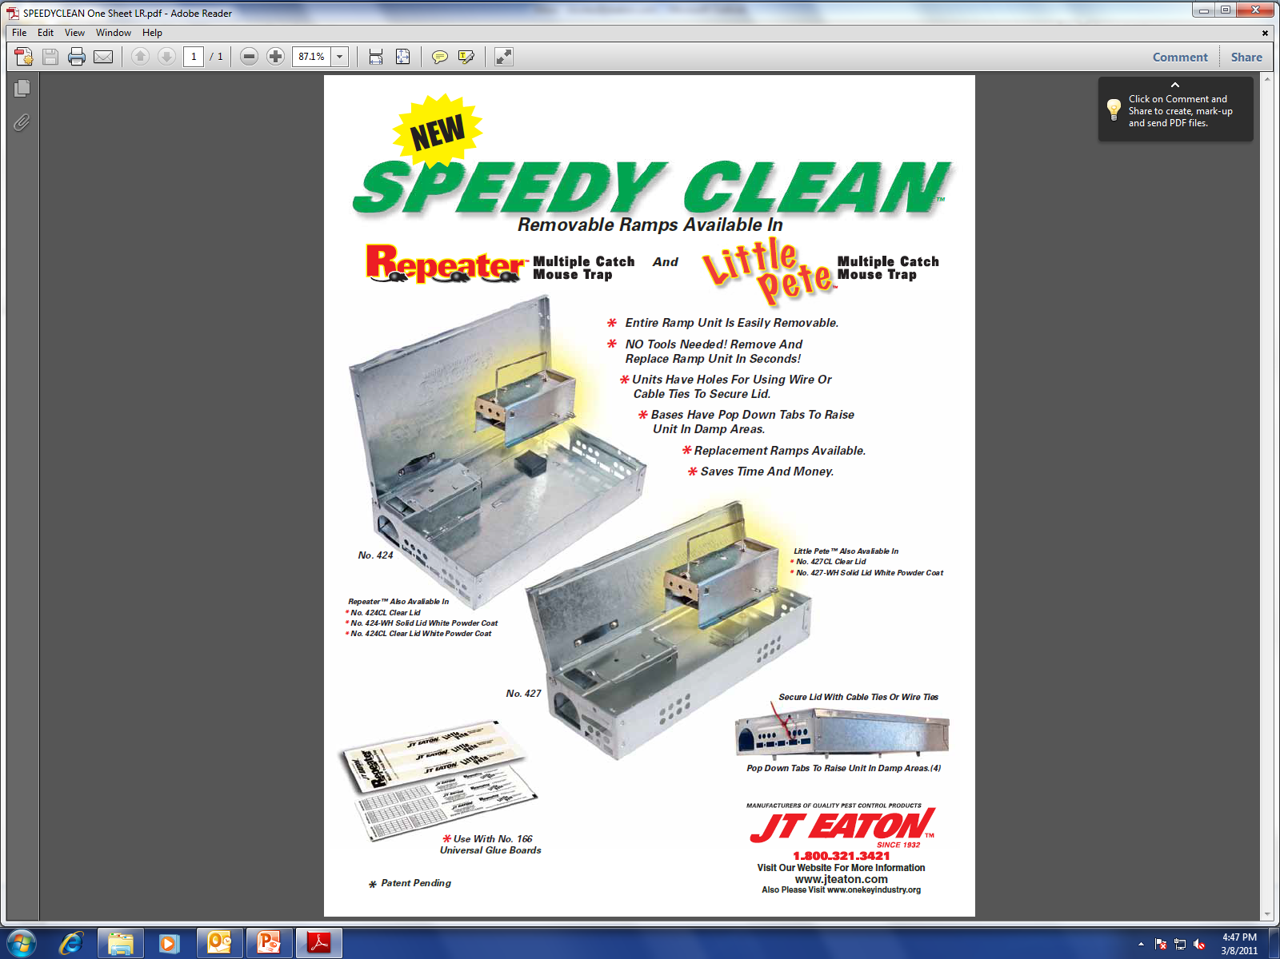
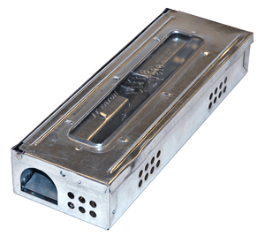
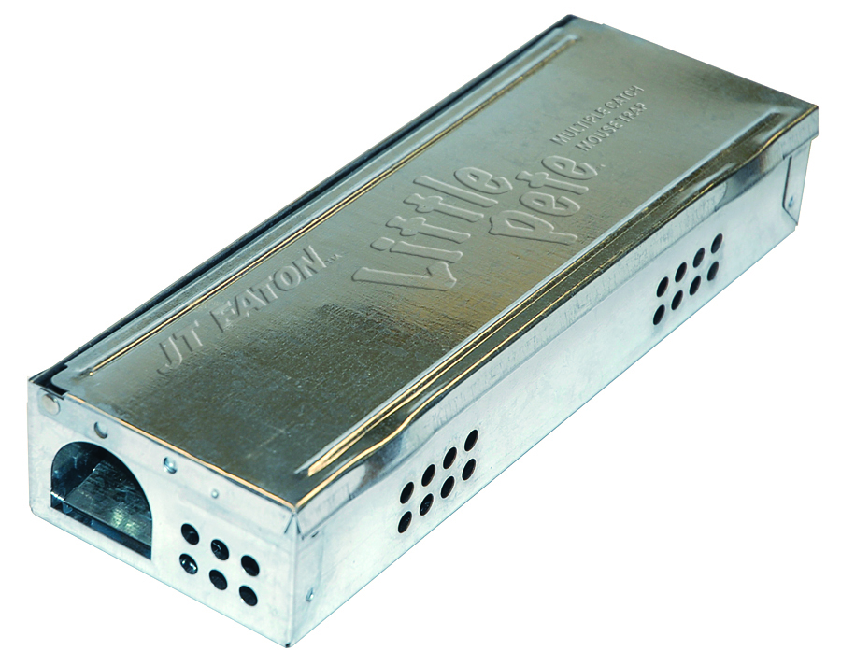
Presents:

Slide 2
Little Pete™ Features:
Slim Line Multiple Catch Mouse Trap
Catches 7-9 live mice
55% narrower than standard Multiple Catch Mouse Traps
Thick gage metal won’t dent easily
Fits in tight spots
Great for High Traffic areas
More placement opportunities

Slide 3
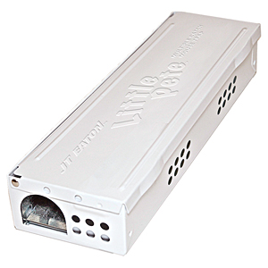
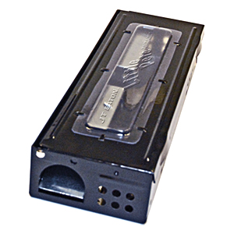
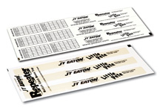
Little Pete™ Features:
Safety Folded Edges reduce cut fingers
Available with inspection window
Inspection holes on three sides
Universal Glue Board available for all models
Available with Chip Resistant powder coating
Private Labeling available

Slide 4
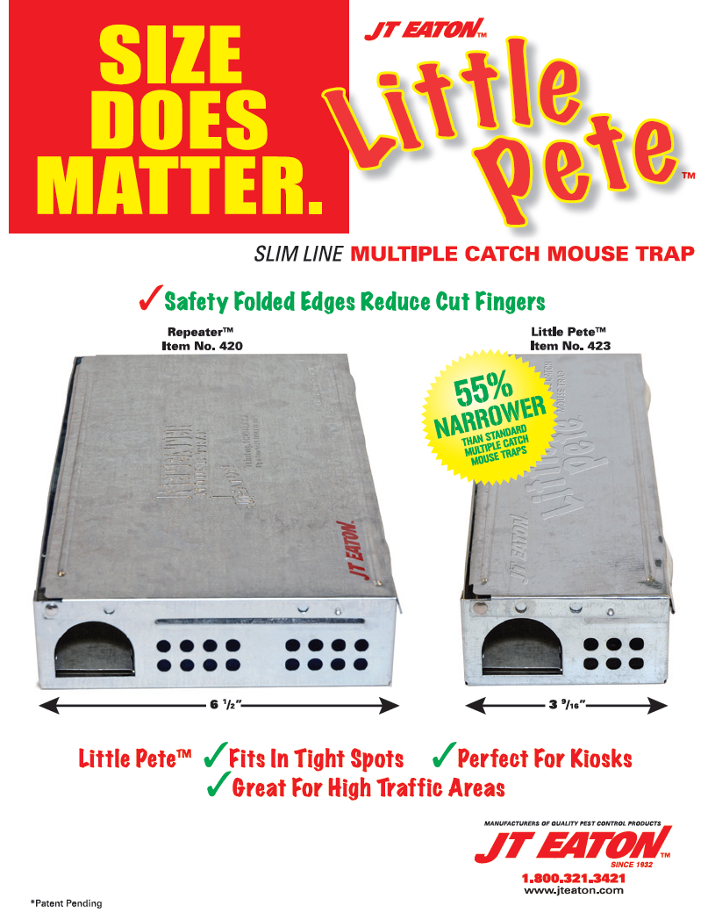
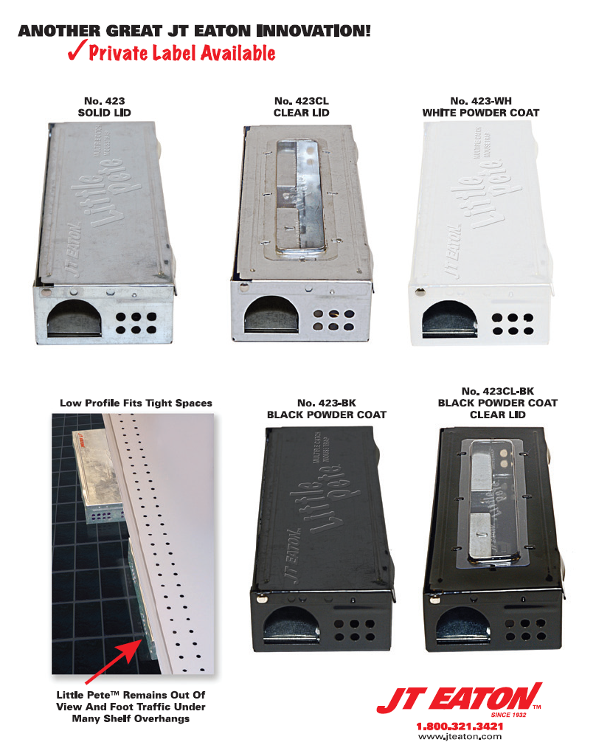

Slide 5
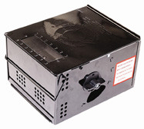
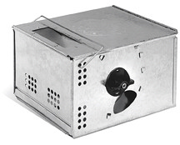
Also Available:
Wind-Up™ Multiple Catch Mouse Trap
  Catch Large numbers of mice the easy way
  Several turns of the handle and the trap is set
  Great for large infestations
  No bait needed, mice will enter looking for harborage
  Also available in Chip Resistant black powder coating

Slide 6
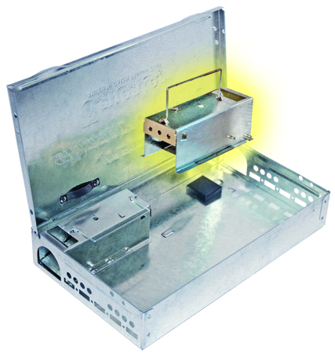
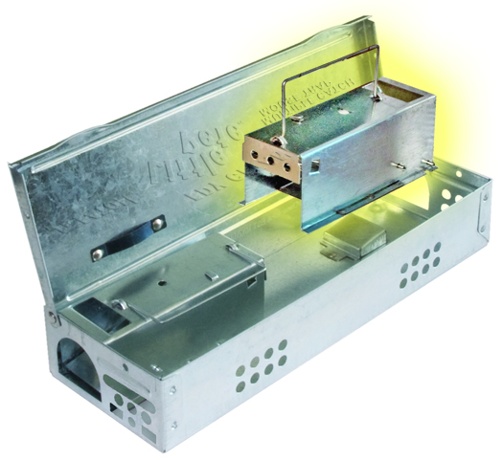
Presents:
Speedy Clean ™

Slide 7
Speedy Clean™ Features:
Available in Repeater™ and Little Pete™ models
Safety Folded Edges reduce cut fingers
Entire Ramp Unit pulls out fast using handle
Clean or replace ramp unit in seconds
Spring Steel locks ramps tight when closed

Slide 8
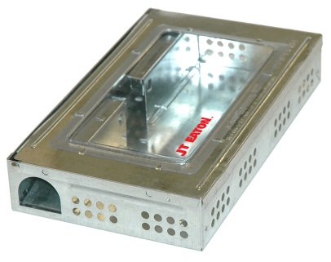
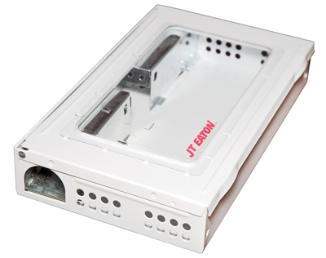
Speedy Clean™ Features:
Universal Glue Board available for all models
Replacement Ramps available
Saves time and money
Available with Inspection Window
Available with Chip Resistant powder coating
Private Labeling available

Slide 9
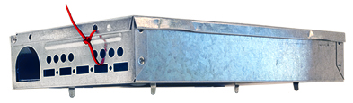
Speedy Clean™ Repeater™ Features:
Units have holes for using wire or cable ties to secure lid
Units have holes for Attaching Service Logs
Bases have Pop Down Tabs to raise unit in damp areas
Units have larger square holes for better insect monitoring
  Fits large insects such as American and Oriental roaches, scorpions and crickets

Slide 10
Universal Glue Board Features:
Fits Repeater™ and Little Pete™ sizes
Fits most competitor multiple catch units
Unscented
Cost effective design
Easy release paper
Easy cut perforated strips
Space between glue strips prevents mice back-up
Packed 100 per box = 300 strips for the Little Pete™

Slide 11
Powder Coating Features:
Baked on white and black powder coating available on Repeater™ and Little Pete™ sizes
Chip, impact, abrasion and corrosion resistant
Muriatic Acid, Nitric Acid and mortar resistant
Detergent and window cleaner resistant
Traps look fresh and new longer

Slide 12
Questions?
1393 E. Highland Rd.
Twinsburg, OH 44087
1-800-321-3421
www.jteaton.com

