Slide 1

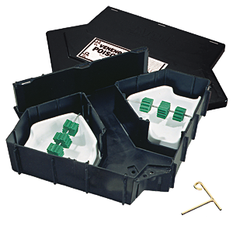
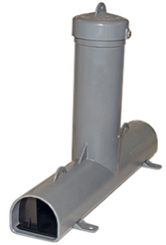
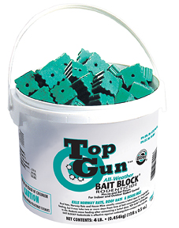

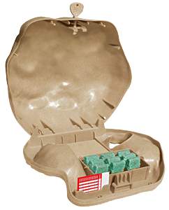
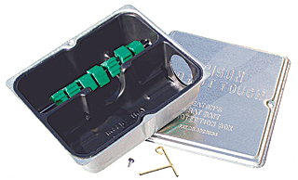
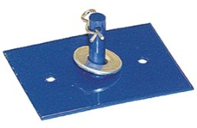

Presents:
Bait Stations and Anchors

Slide 2
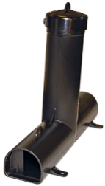

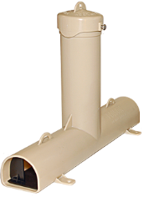
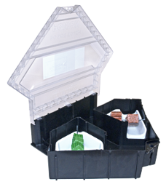
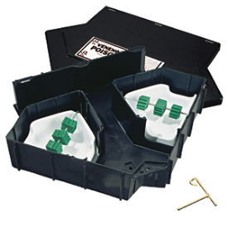
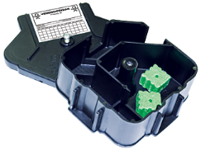
Tamper Resistant Bait Stations
Top Loader™
Rat and Mouse Fortress™

Slide 3
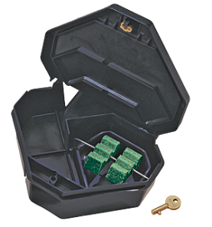
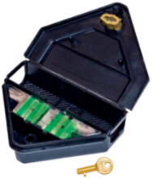
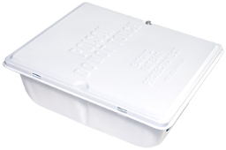
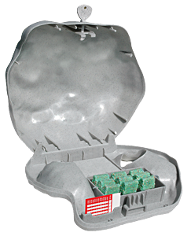
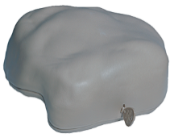
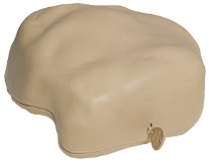
Tamper Resistant Bait Stations
Rat and Mouse Depot™
Strongbox™
Rodent Rock ™

Slide 4
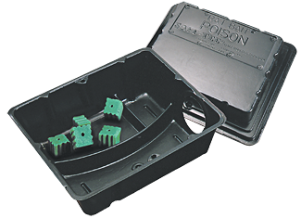
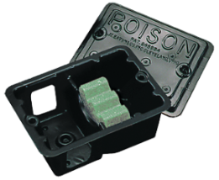
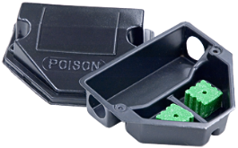
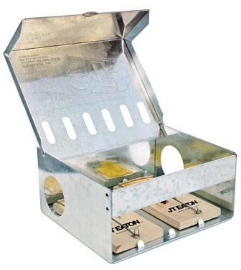
Other Bait Stations
Rat Size Safe-Tee™ Bait Station
Plastic Mouse Size Bait Stations
Rat Size Snap Trap Station

Slide 5

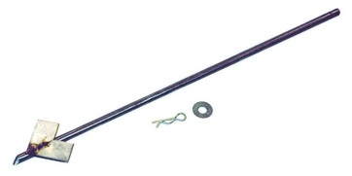


Anchors *Maximum Bait Station Protection*
Earth Anchor
Cotter Pin Stake
Flat Plate Stake
Permatite Bait Stake
Aluminum Cable Stake

Slide 6

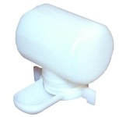





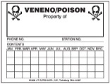
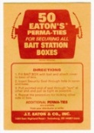
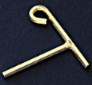


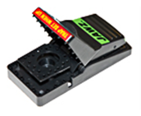
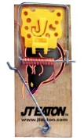
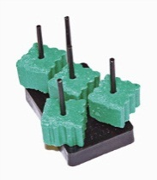
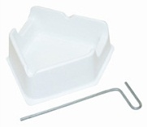
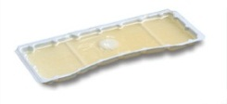
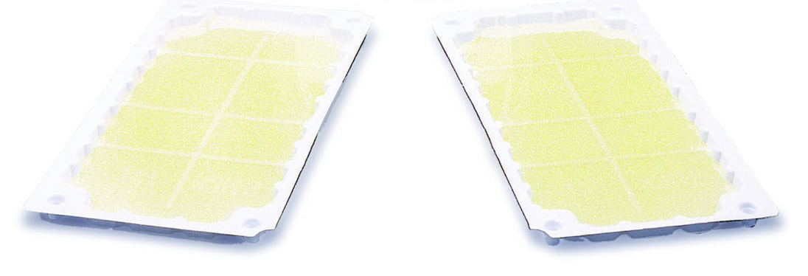
Accessories
Liquid Bait Dispensers
Service Logs and Signs
Security Ties
Keys
Other Inserts

Slide 7
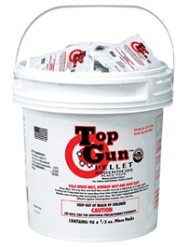
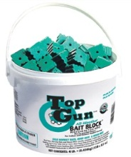
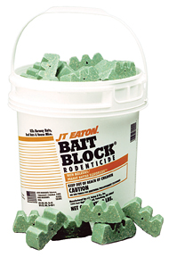
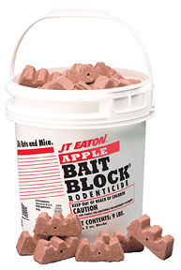
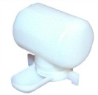
Bait
Top Gun™
Bait Block®
Liquid Bait

Slide 8
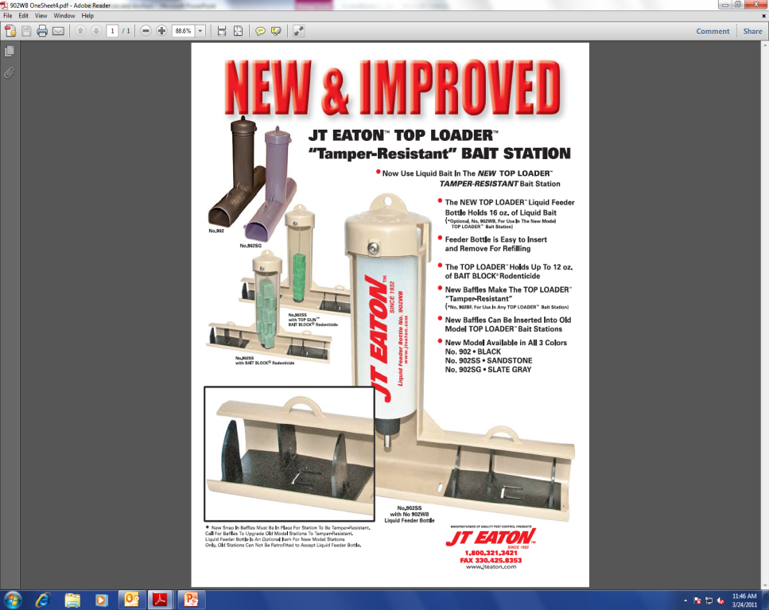
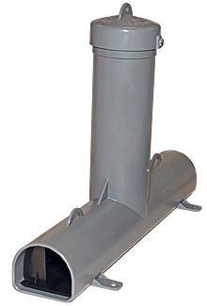
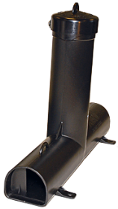
Top Loader™
Use with all types of rodents
Easy Loading with Dual Entry
Use Bait Block® or Liquid Bait
Holds large amount of bait
Keeps bait dry
Added baffles for Tamper Resistance
Available in black, sandstone and slate gray coloring

Slide 9
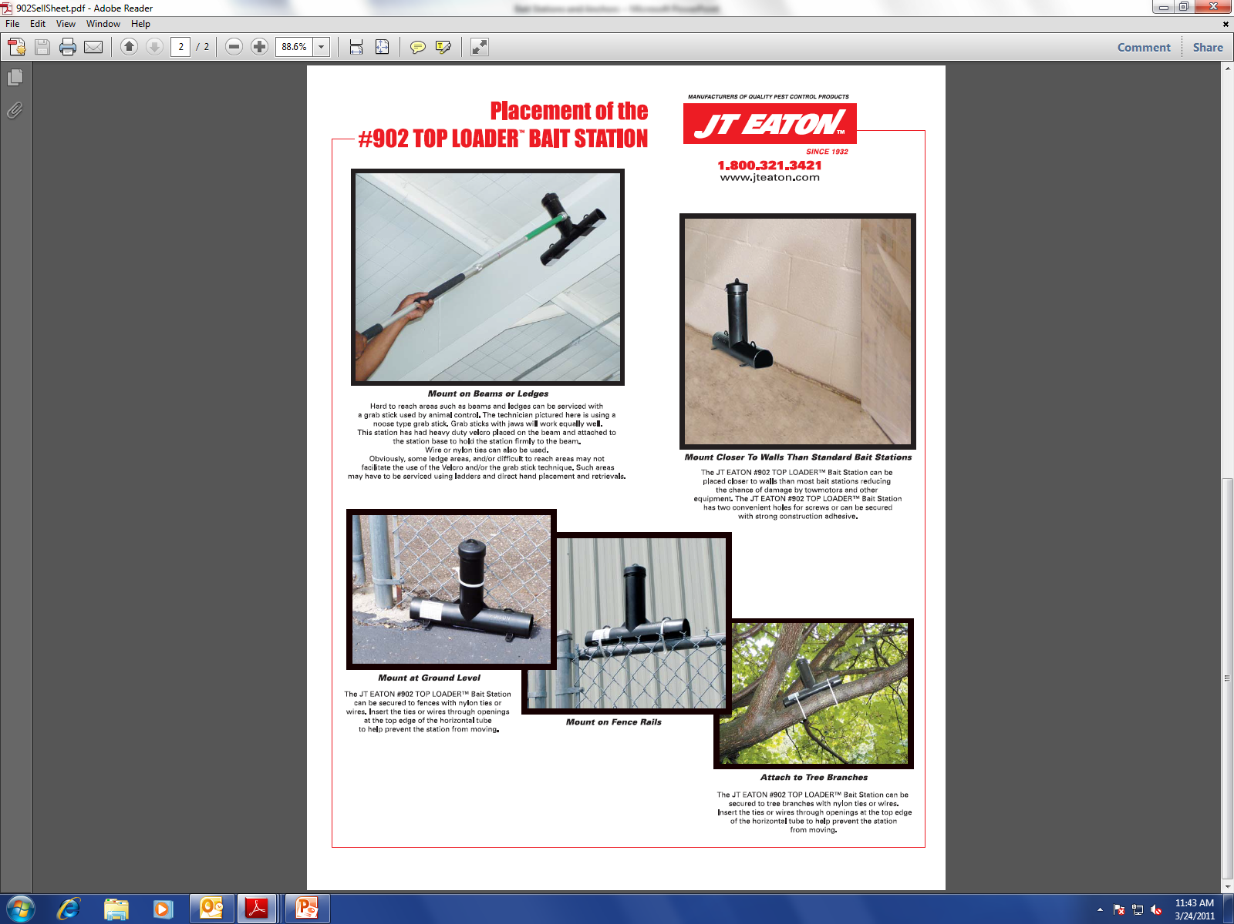
Top Loader™
Mount on various structures

Slide 10
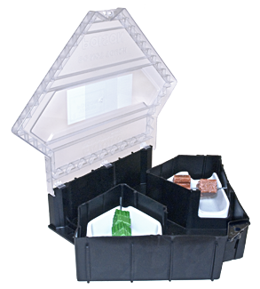
Rat Fortress™
Easy to open with removable lid
Rat size openings with dual entry
Stainless steel, Anti-Corrosive locking system
Triangular shape fits into corners and along walls
Made of strong, rigid plastic
Tamper Resistant
Internal baffles secure bait
Also available with clear lid

Slide 11
Rat Fortress™
Removable insert trays with bait securing rods
Includes Allen wrench for easy opening
Can be secured with hole in base
Holds 2 Jaws rat traps or 4 Jaws mouse traps
Holds Green’s™ Vertical Bait Holder
Holds 2 Stick-Em® glue traps
Holds liquid bait dispenser

Slide 12
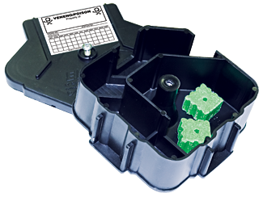
Mouse Fortress™
Easy to open with removable lid
Mouse size openings with dual entry
Stainless steel, Anti-Corrosive locking system
Triangular shape fits corners and along walls
Includes Allen wrench for easy opening
Use with Bait Blocks® or Place Packs
Can be secured using hole in base
Made of strong, rigid plastic
Tamper Resistant with internal baffles

Slide 13
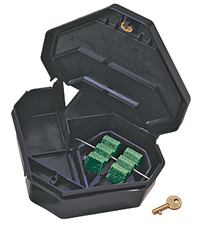
Rat Depot™
Easy open lid with hinge
Rat size openings with dual entry
Internal baffles secure bait
Tamper Resistant
Includes “Gold Key” for easy opening
Triangular shape fits into corners and along walls
Locks have drain holes to prevent freezing

Slide 14
Rat Depot™
Removable insert trays with bait securing rods
Can be secured with hole in base
Holds a Jaws rat trap or 2 Jaws mouse traps
Holds Green’s™ Vertical Bait Holder
Holds a Stick-Em® glue trap
Holds liquid bait dispenser

Slide 15
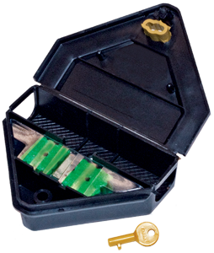
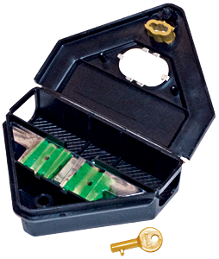
Mouse Depot™
Easy open lid with hinge
Mouse size openings with dual entry
Internal baffles secure bait
Includes “Gold Key” for easy opening
Triangular shape fits corners and along walls
Can be secured with hole in base
Use with Bait Block®
Tamper Resistant
Available with viewing window

Slide 16
Strongbox™
Durable galvanized steel construction
Seamless base for added strength
Rat size openings with dual entry
Anti-Corrosive locking system
  Can lock with screws (included)
  Can also use metal lock
Indoor and outdoor use
Tamper Resistant

Slide 17
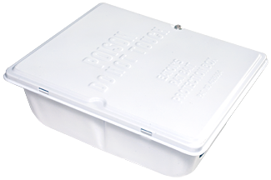
Strongbox™
Black plastic insert
  Insulates bait and keeps it cool
  Allows for fast servicing
  Simulates darkness for ease of capture
Includes bait securing rod
Available for Private Label and in White Powder Coating
Two holes in base for anchor securing

Slide 18
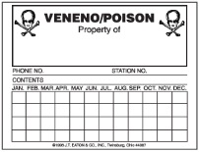
Safe-Tee™
Rat size dual entry
Recommended for indoor use
Space for service log
Holds Green’s™ Vertical Bait Holder
Can be used with glue trap insert
Holds a Jawz Rat Trap
Holds liquid bait dispenser
Includes 50 security ties
Non-Tamper Resistant

Slide 19
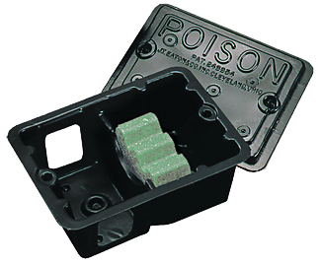
Square Mouse Size Plastic Station
Mouse size dual entry
Recommended for indoor use
Space for service log
Includes 50 security ties
Compact and economical
Non-Tamper Resistant

Slide 20
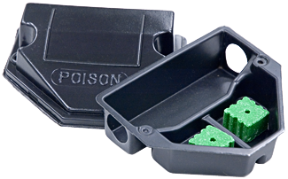
Triangular Mouse Size Plastic Station
Mouse size dual entry
Recommended for indoor use
Space for service log
Double compartment holds dry and liquid baits
Compact and economical
Triangular design fits close to walls and in corners
Non-Tamper Resistant

Slide 21
Rat Snap Trap Station
Hides traps from view
Durable, galvanized steel for long life
Rat size holes with dual entry
Holds two Wooden Rat Size Snap Traps or two Jawz Rat Traps
Tabs for locking traps in place
Front space for service logs or company label
Great for non-bait or non-poison situations
Hole in base for securing with anchor

Slide 22

Rodent Rock ™
Blends in with ground cover
Use with Top Gun™ and Bait Block®
Includes service logs, bait holder, rods and keys
Side openings for rodent entry under station
Durable, easy to open, with internal baffles
Available in slate gray, sandstone and granite coloring

Slide 23

Rodent Rock™ Anchors
Aluminum Cable Stake
Permatite Bait Stake

Slide 24

Other Anchors
Earth Anchor
  For use with all bait stations
  Packed 50 per case with 2 pounding rods
Cotter Pin Stake
  For securing stations outdoors (not for concrete)
  Cannot be used for Rodent Rock™
Flat Plate Stake
  For securing stations indoors and outdoors
  Ideal for securing to asphalt and concrete
  Cannot be used for Rodent Rock™
Aluminum Cable Stake
  For securing stations outdoors

Slide 25


Coming Soon…

Slide 26
Questions?

