Slide 1

Lock-Up® Premium Mattress, Box Spring and Pillow Encasements

Slide 2
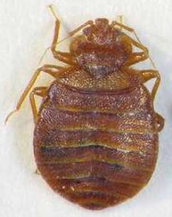
Why Use Mattress and Box Spring Encasements?
Can be used proactively for the early detection of bed bugs.
If secure, can protect the value of a mattress and box springs.
Can aid in controlling bed bugs in an infested dwelling.
Important that the encasement has been specifically tested and designed to be effective against bed bugs.

Slide 3

Why Use Mattress and Box Spring Encasements?
Keeps bed bugs inside and prevents those trapped bugs from biting you.
Prevents bed bugs from setting up harborage in mattresses and box springs.
Not all encasements are created equal!

Slide 4
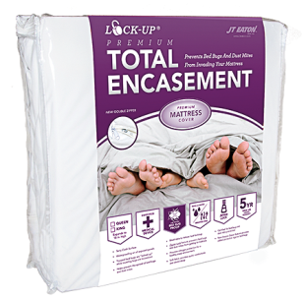
Lock-Up® Premium Total Encasement Mattress Cover
Guaranteed to trap bed bugs in mattresses and keep new bed bugs from entering.
Waterproof, durable and breathable Terry Cloth fabric cover.
Three sided Double Zipper system for easy installation.
Zipper Lock feature prevents bed bugs and dust mites from getting to mattress.

Slide 5
Lock-Up® Premium Total Encasement Mattress Cover
Impermeable to Mold and Bacteria
Allergy and Dust Mite Protection
Silent for a Safe and Sound Sleep
Highest Quality yet Economical
Certified for Bed Bug Protection
Machine Washable
5 Year Limited Warranty

Slide 6
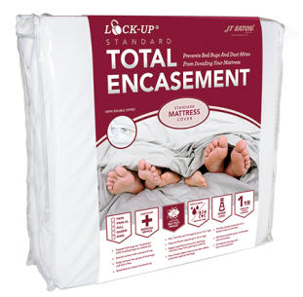
Lock-Up® Standard Total Encasement Mattress Cover
Guaranteed to trap bed bugs in mattresses and keep new bed bugs from entering.
Waterproof, durable and breathable Stretch Knit fabric cover.
Three sided Double Zipper system for easy installation.
Zipper Lock feature prevents bed bugs and dust mites from getting to mattress.

Slide 7
Lock-Up® Standard Total Encasement Mattress Cover
Impermeable to Mold and Bacteria
Allergy and Dust Mite Protection
Silent for a Safe and Sound Sleep
Highest Quality yet Economical
Certified for Bed Bug Protection
Machine Washable
1 Year Limited Warranty

Slide 8
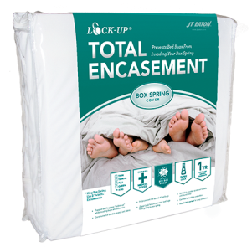
Lock-Up® Total Encasement Box Spring Cover
Guaranteed to trap bed bugs in mattresses and keep new bed bugs from entering.
Soft, fabric cover with double knit body.
Durable and breathable (reduces heat build up and sweating).
Three sided zipper for easy installation.
Zipper Lock feature prevents bed bugs and dust mites from getting to mattress.

Slide 9
Lock-Up® Total Encasement Box Spring Cover
Allergy and Dust Mite Protection
Certified for Bed Bug Protection
Double Reinforced Corners for Snag Protection
Protector Pads included for extra protection
Highest Quality yet Economical
Machine Washable
1 Year Limited Warranty

Slide 10
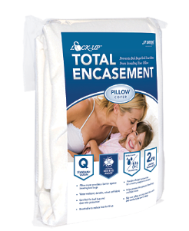
Lock-Up® Total Encasement Pillow Cover
Impermeable to Mold and Bacteria
Allergy and Dust Mite Protection
Smooth, Comfortable Velvet Fabric
Easy-Fit, Side Zippered Pillow Protector
Quiet for a Sound Sleep
Certified for Bed Bug Protection
Machine Washable
2 Year Limited Warranty

Slide 11
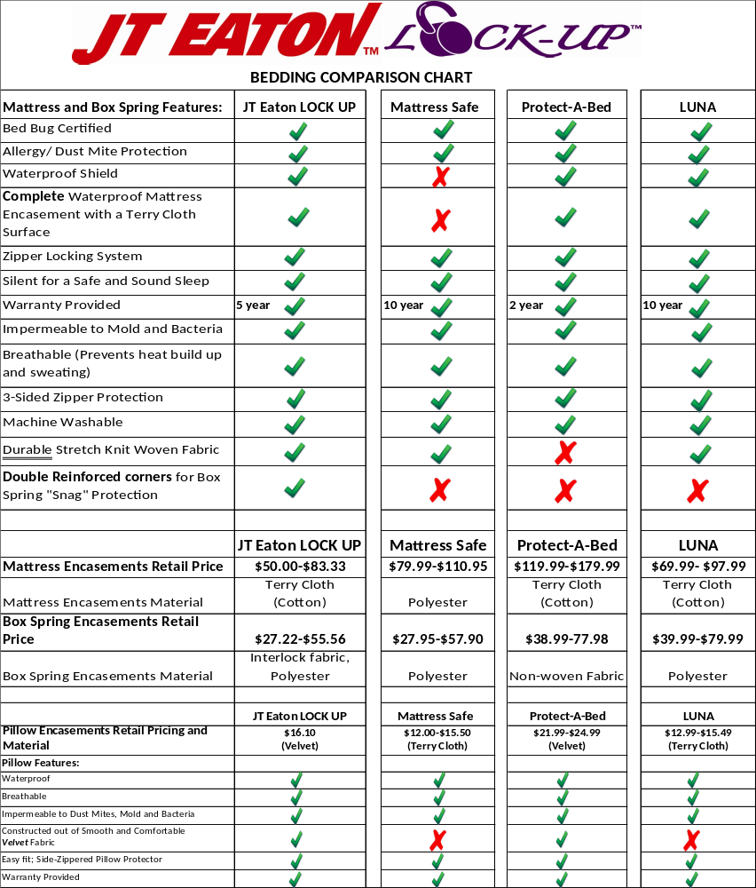
Premium Encasement feature comparison shows our product is the best on the market.

Slide 12
Other Bed Bug Products
Kills Bedbugs and Crawling Insects Powder
Kills Bedbugs Spray
Kills Bedbugs II Spray
Kills Bedbugs, Ticks and Mosquitoes Spray
Kills Bedbugs PLUS Aerosol Spray
Lock-Up® Bed Bug Barriers
    Use according to label

Slide 13
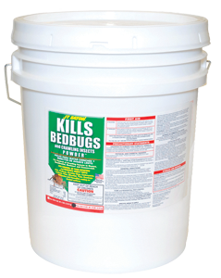
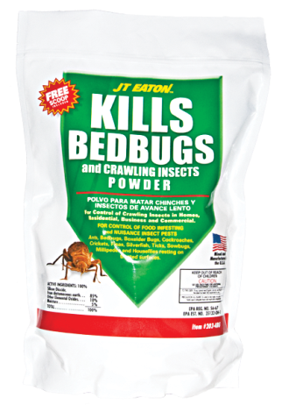
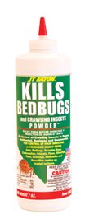

Kills Bedbugs and Crawling Insects Powder
Diatomaceous Earth
3 oz. and 7 oz. Puffer Bottle
4 lb. and 10 lb. Pail
Chemically Inert & Odorless
Made from Freshwater Diatoms
Removes Water-Proofing Oils
Insects Die from Dehydration
Mined and Manufactured in the USA

Slide 14
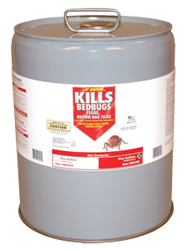
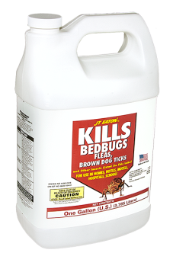
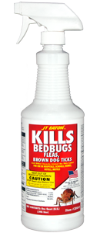
Kills Bedbugs Spray
Oil Base Pyrethrin
Quick Knockdown and Kill
No Residuals
1 qt. and 1 gal. Spray Bottle
5 gal. Pour Spout Pail
Can be Sprayed Directly on Mattress
Manufactured in the USA

Slide 15
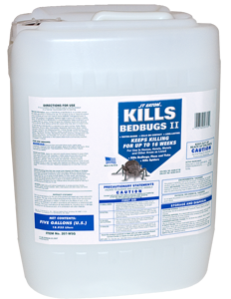
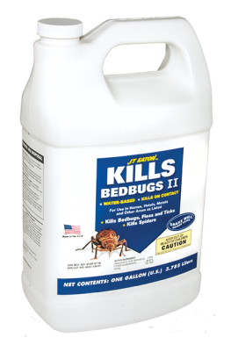
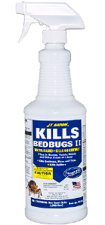

Kills Bedbugs II Spray
Water Base Deltamethrin
Kills on Contact
Long Lasting
6 oz., 12 oz., 1 qt. & 1 gal. Spray Bottle
5 gal. Pour Spout Pail
Can be Sprayed Directly on Mattress
Manufactured in the USA

Slide 16
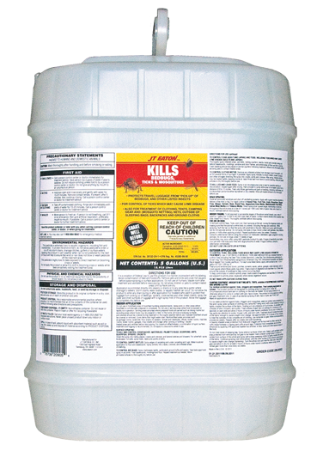
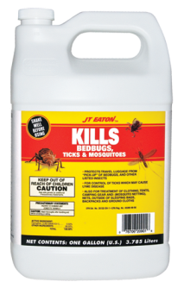
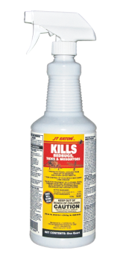
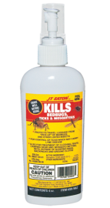

Kills Bedbugs, Ticks and Mosquitoes
Water Base Permethrin
Spray Clothing and Luggage
Spray Tent and Camping Gear
Spray Mattress and Bedding
Can be Sprayed Directly on Mattress
3 oz., 6 oz., 1 qt. and 1 gal. Spray Bottle
5 gal. Pour Spout Pail
Manufactured in the USA

Slide 17
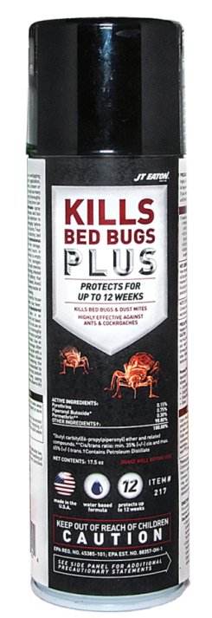
Kills Bedbugs PLUS Aerosol
17.5 oz. Water Base Aerosol Spray
Pyrethrins and Permethrin
12 Weeks Residual Protection
Kills on Contact
Effective on Resistant Bedbugs
Kills Bedbugs, Ants, Roaches, Dust Mites and Other Insects Listed on the Label
NEW!

Slide 18
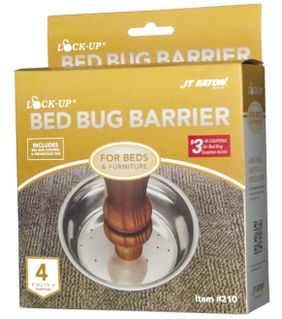
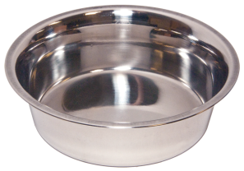
Lock-Up® Bed Bug Barrier
Monitor Bedbugs
Prevent from crawling up furniture
Stainless Steel
Use with any legged furniture

Slide 19
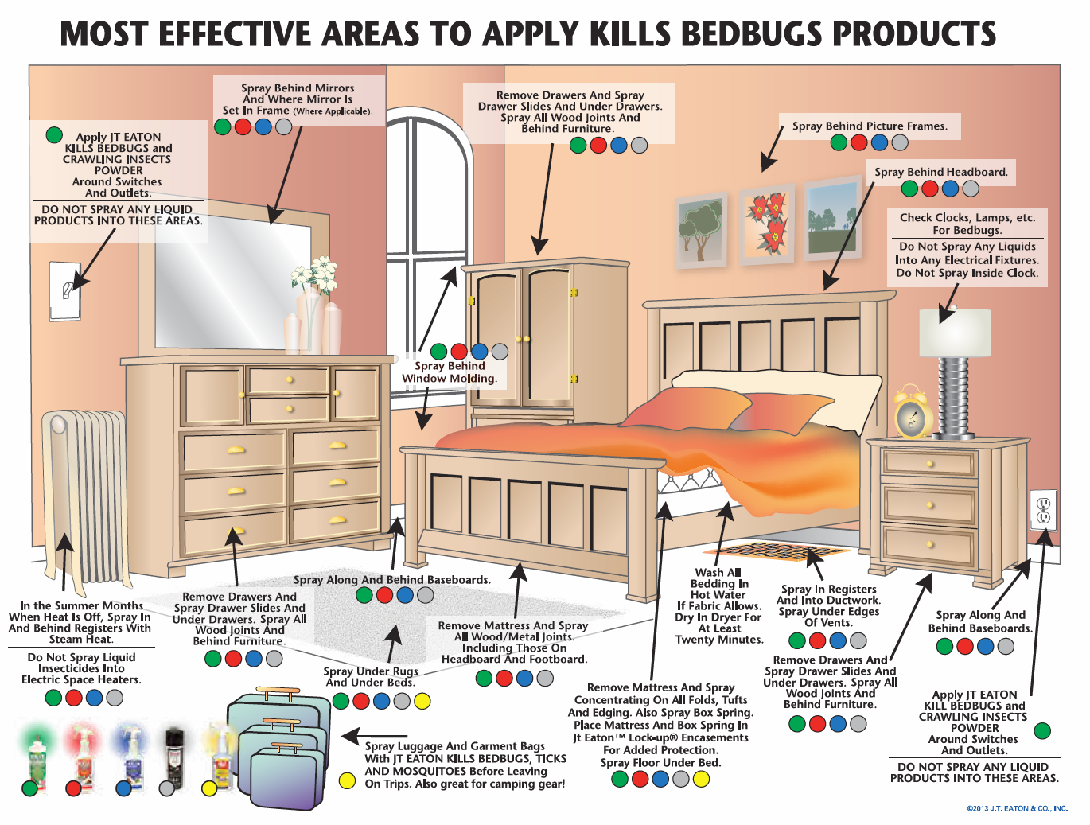

Slide 20
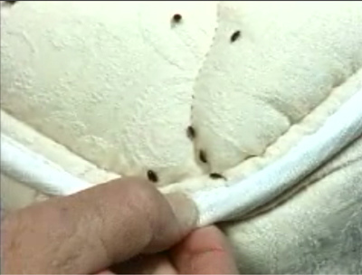
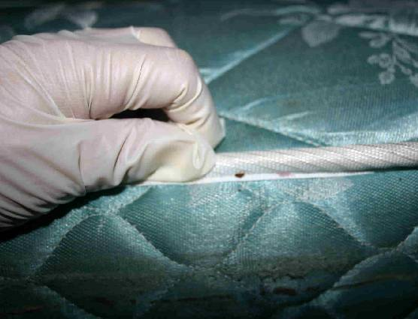
Questions?

