Slide 1
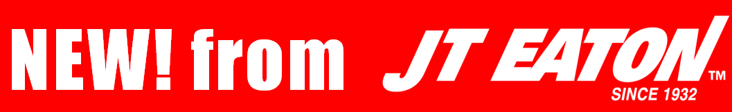
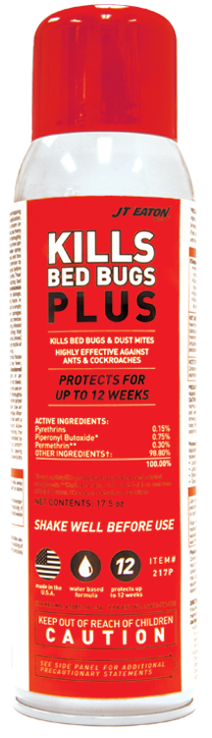
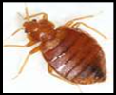


KILLS
BED BUGS PLUS
#217P
Aerosol Spray

Slide 2
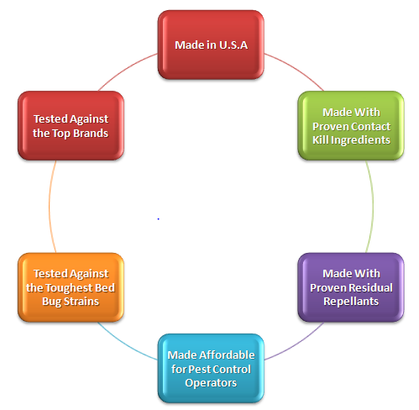

We Designed KILLS BED BUGS PLUS
To Be The Best!
Notes:
Contact kill product: Pyrethrins 0.15%, Piperonyl Butoxide 0.75% Synergist Residual Repellent: Permethrin 0.30%

Slide 3
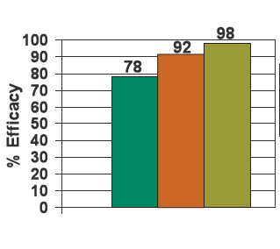

We Tested It Against The Toughest Bed Bugs
And Won!
Knockdown and Kill of Resistant: Cincinnati Strain of Bed Bugs with JT Eaton KILLS BED BUGS PLUS:

Slide 4
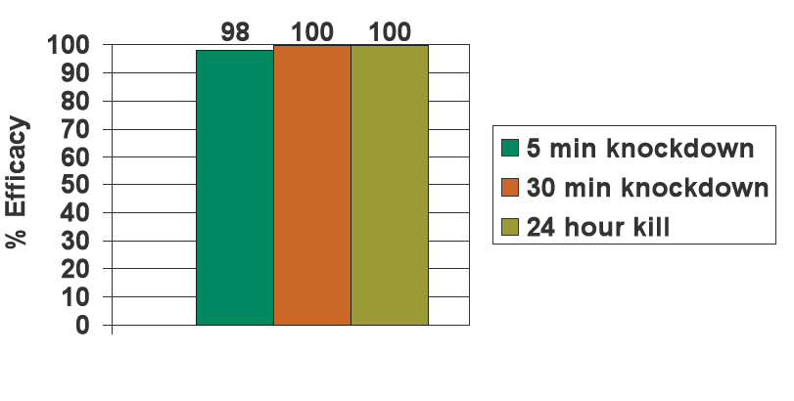
We Tested It Against The Toughest Bed Bugs And Won!
Knockdown and Kill of Susceptible: Harlan Strain of Bed Bugs with JT Eaton KILLS BED BUGS PLUS:

Slide 5
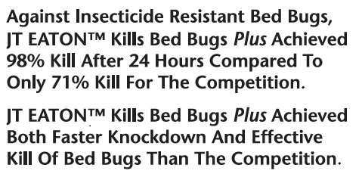
We Tested For The Fastest Kill And Won!

Slide 6
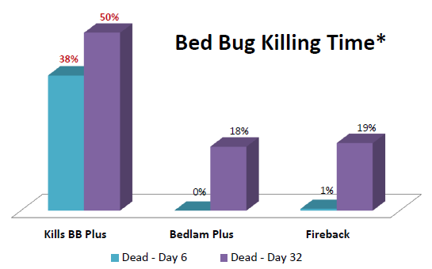
We Tested It Against The Top Competitors
And Won!
Bed Bugs Killed after 6 days and 32 days
with JT Eaton KILLS BED BUGS PLUS:

Slide 7
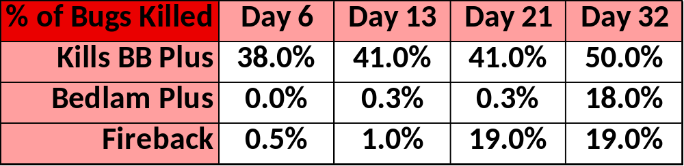
We Had It Independently Tested On Bed Bugs
And Won!
Results of #217P KILLS BED BUGS PLUS Independent Testing:
Study: Pressurized Aerosol Insecticide Formulations
Began: 4/13/2013
Completed: 5/20/2013
Products Tested:
J.T. Eaton (E217) Kills Bed Bug Plus® vs. MGK Bedlam Plus® vs. Nisus Fireback®

Slide 8
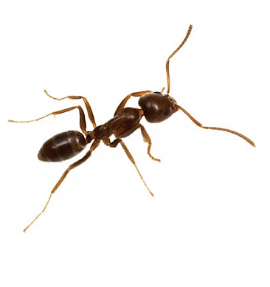
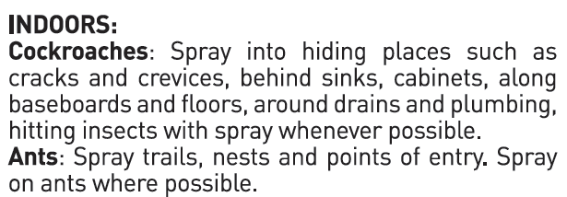
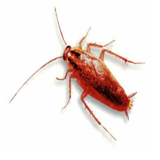
Kills Bed Bugs … PLUS

Slide 9
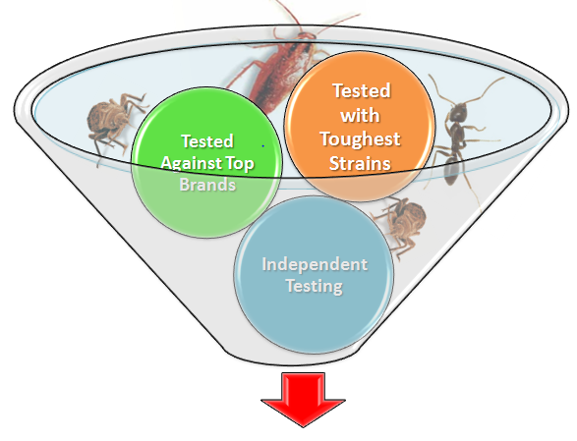
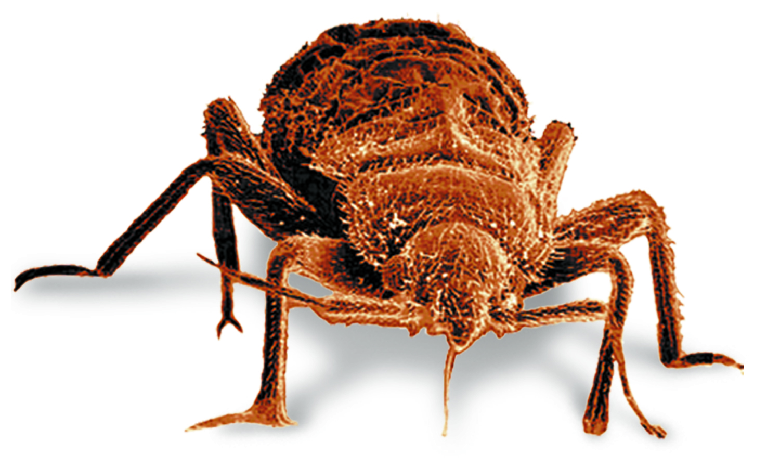

Designed For Your Success!

Slide 10
Test It For Free And You Decide…
Contact
Western States: James Rodriguez James@jteaton.com
Texas, OK, LA: Dean Osborn Dean.Osborn@icloud.com
Midwest States: Craig Velte CraigV@jteaton.com
Eastern States: Craig Martelle CraigM@jteaton.com
Office: 1.800.321.3421 orders@jteaton.com

